Slide 1
Learning-Aided 3-D Occupancy Mapping With Bayesian Generalized Kernel Inference
Peihan Zhang
2019-11-6

Slide 2
目录 Contents
1
Paper
2
Experiment：VICON vs Odom

Slide 3
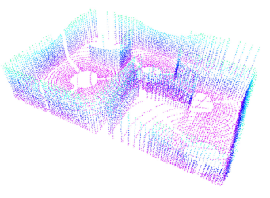
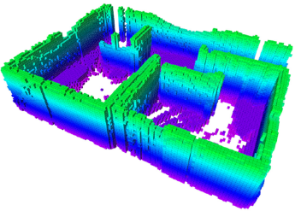
Learning-Aided 3-D Occupancy Mapping With Bayesian Generalized Kernel Inference
range sensor data 3D map
Feature：
Using Bayesian Kernel Inference for prediction of occupancy in locations not directly observed by a range sensor
Able to apply to continuous maps
apply recursive Bayesian updates, inference is efficient on discrete maps

Slide 4
Introduction
Traditional
Cells in grid map are considered independent
Fail to make use of local context to predict occupancy in unobserved areas
sparsity and noise in range sensor data can leave gaps and inconsistencies in maps misleading in robot planning and exploration scenarios
Idea:
make use of local context to predict occupancy in unobserved areas

Slide 5
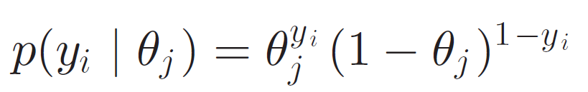
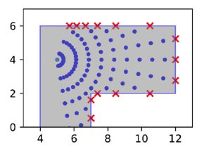
Background-counting sensor model
For map cell j :
occupancy probability θj has the Bernoulli likelihood:
yi ∈{0, 1}: at position Xi of sensor ray, whether the beam was reflected by or passed through
free space : yi = 0, sampled along the beam
occupied space: yi = 1, end points of the beam

Slide 6
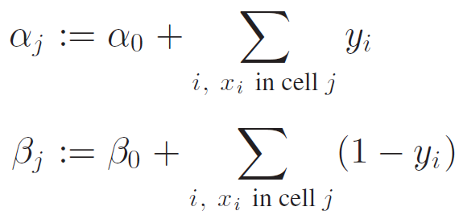
Background-counting sensor model
Applying Bayes rule, we get posterior is given by Beta(αj, βj )
αj: count of reflected beam in the jth grid cell (occupied)
βj: count of beam passed through the jth grid cell (free)

Slide 7
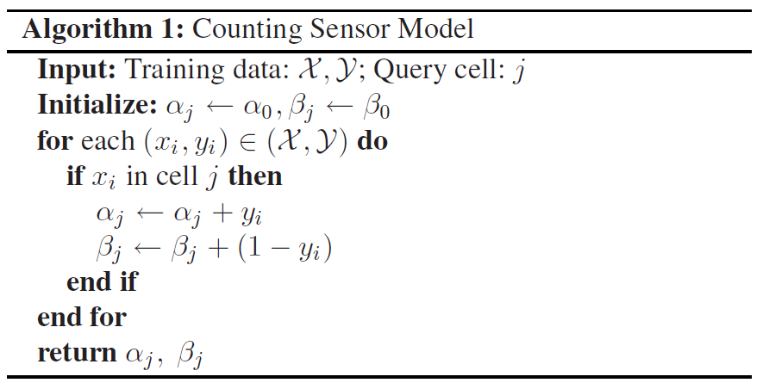
Background-counting sensor model

Slide 8
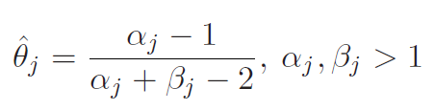
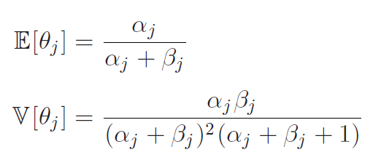
Background-counting sensor model
The maximum a posteriori estimate of θj:
Property

Slide 9
Background-counting sensor model
Review:
What:
Given observations X, Y,
compute the occupying possibility for a query cell j
Where:
discrete grid maps

Slide 10
Bayesian Generalized Kernel Inference
Adapt this method to the continuous domain
Problem:
Not every point in the map has sensor observations (data is discrete)
Idea:
Consider points in the local neighborhood of a query point for reasoning

Slide 11
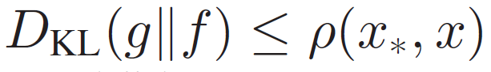

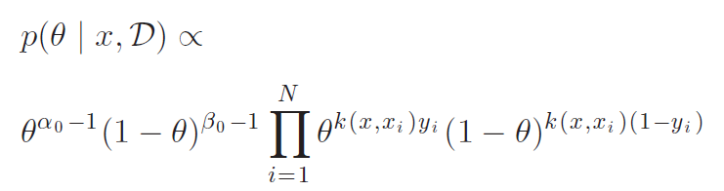
Bayesian Generalized Kernel Inference
How to describe the smooth distribution?
Kullback–Leibler divergence (KL散度)：a measure of how one probability distribution is different from a second
If： then
Approximate continues using discrete

Slide 12
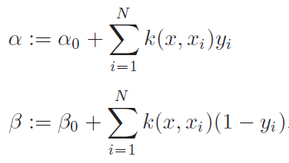
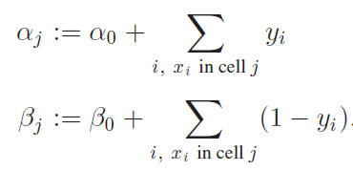

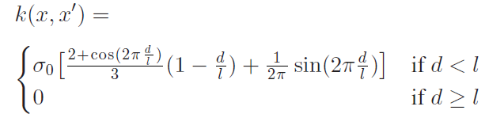

Bayesian Generalized Kernel Inference
continues Discrete
Kernel function： a weight related to distance

Slide 13
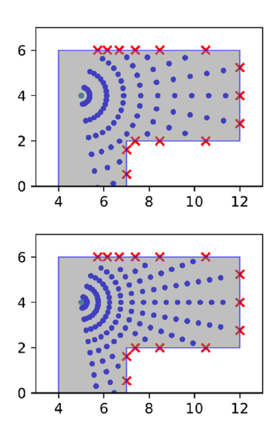
Bayesian Generalized Kernel Inference
The problem of free space representation
More points of free space， bigger β
Result：
bias the model toward predicting free space

Slide 14
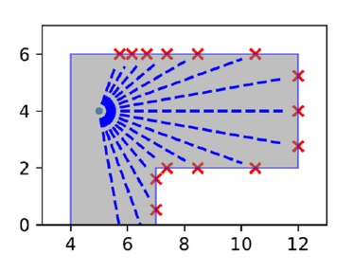
Bayesian Generalized Kernel Inference
The problem of free space representation
Solution： Using Point-to-Line distance

Slide 15
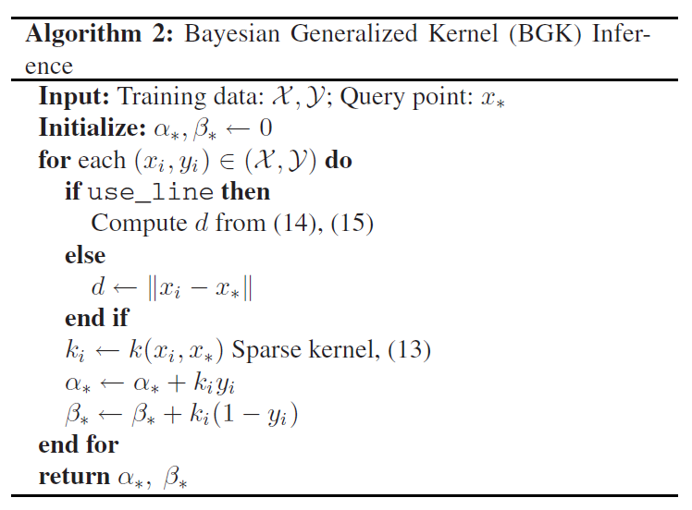
Bayesian Generalized Kernel Inference

Slide 16
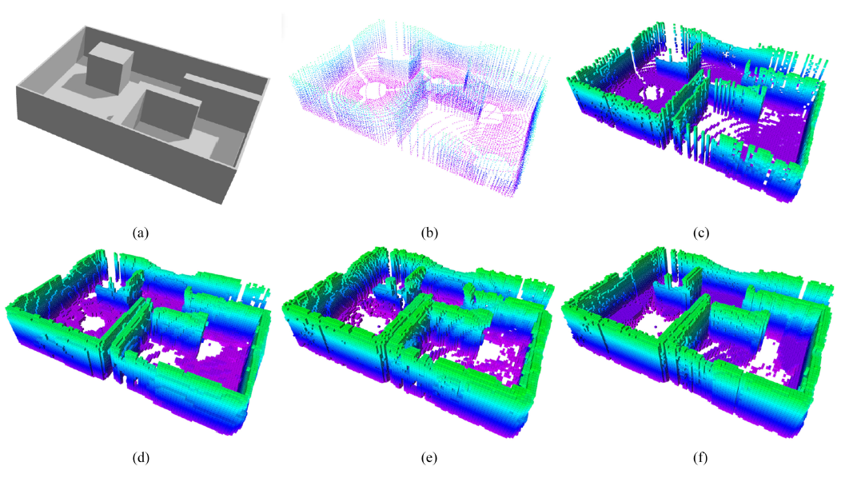
Experiments
Environment model.
Raw data.
OctoMap
BGKOctoMap.
GPOctoMap.
BGKOctoMap-L

Slide 17
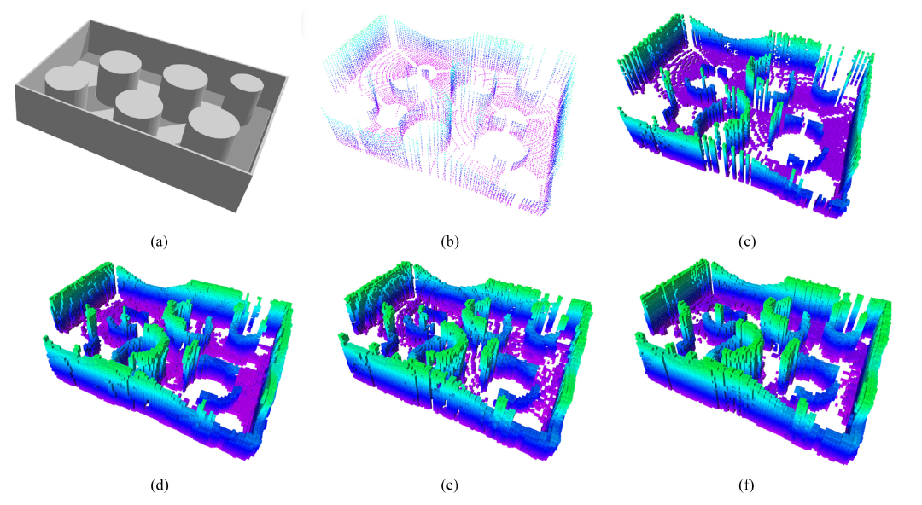
Experiments
Environment model.
Raw data.
OctoMap
BGKOctoMap.
GPOctoMap.
BGKOctoMap-L

Slide 18
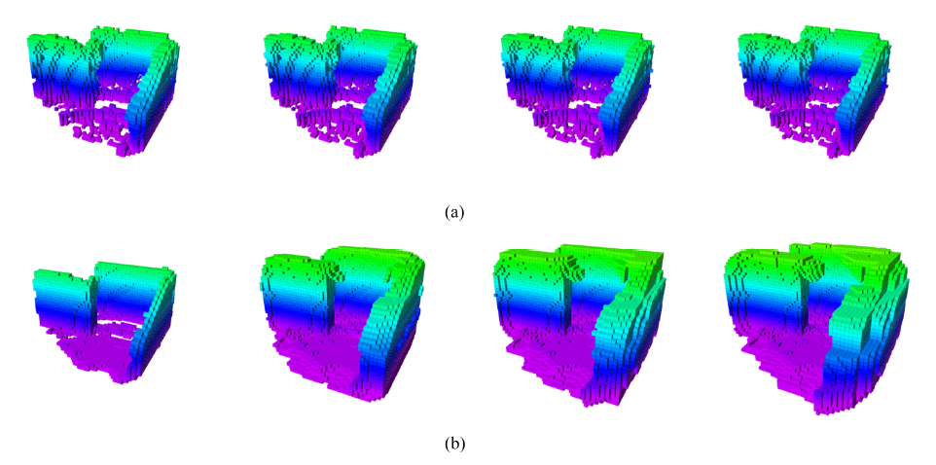
Experiments-station keeping
BGKOctoMap.
OctoMap
GPOctoMap

Slide 19
目录 Contents
1
Paper
2
Experiment：VICON vs Odom

Slide 20
Method
Purpose: To demonstrate the accuracy of odometer of the UGV.
Method:
Vicon > Pose Data > Set Origin
Rotate to Align Data > compare
Odom > Pose Date >

Slide 21
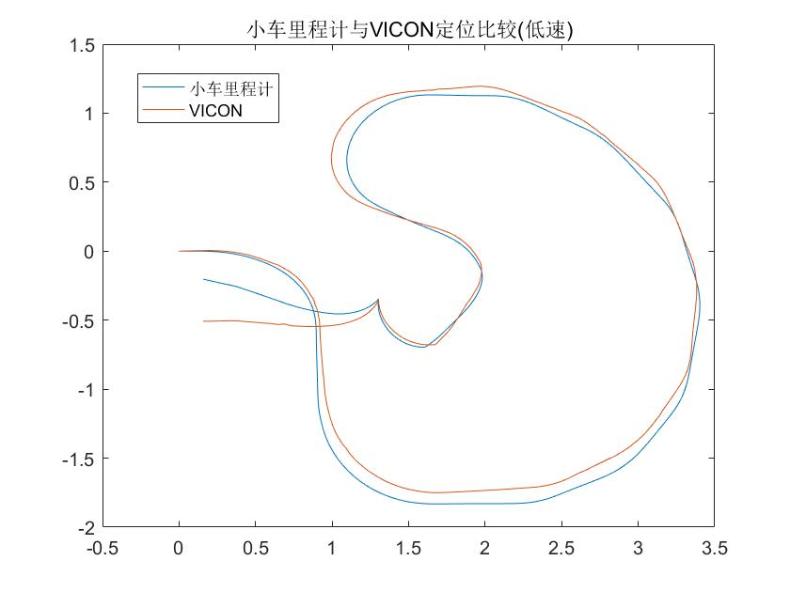
Speed

Slide 22
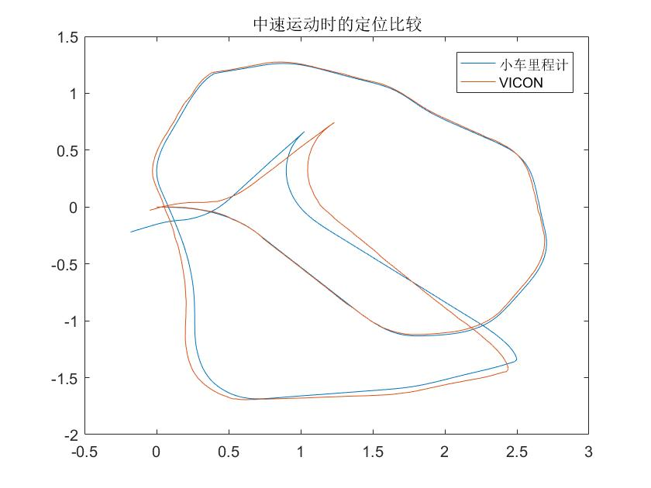
Speed

Slide 23
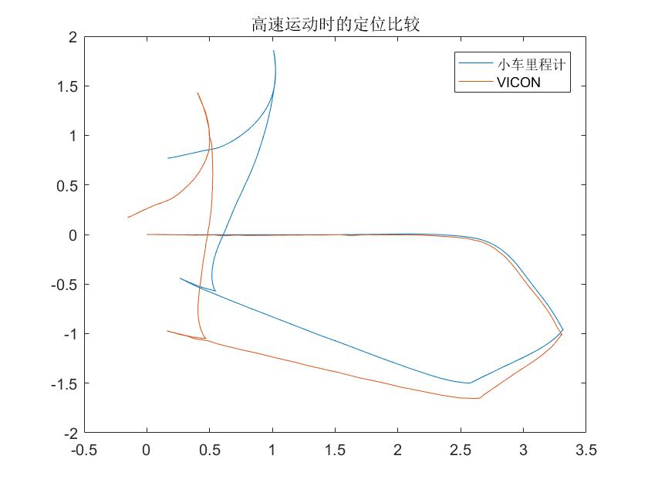
Speed

Slide 24
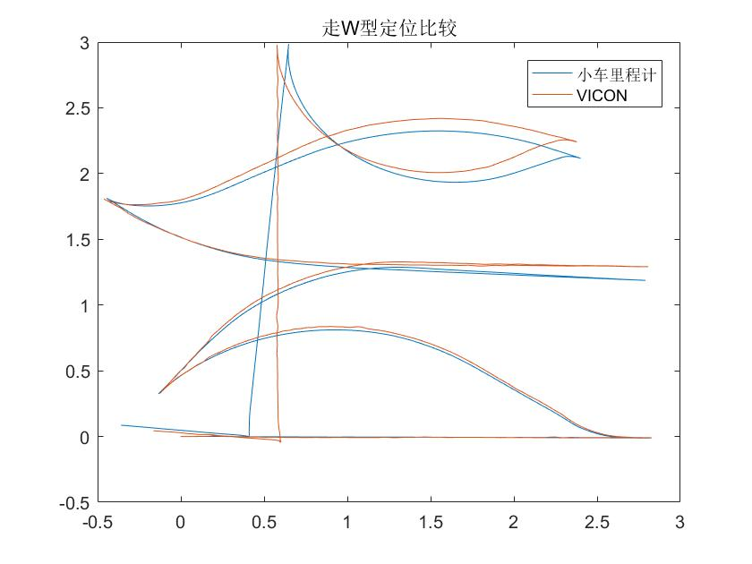
Motion Pattern

Slide 25
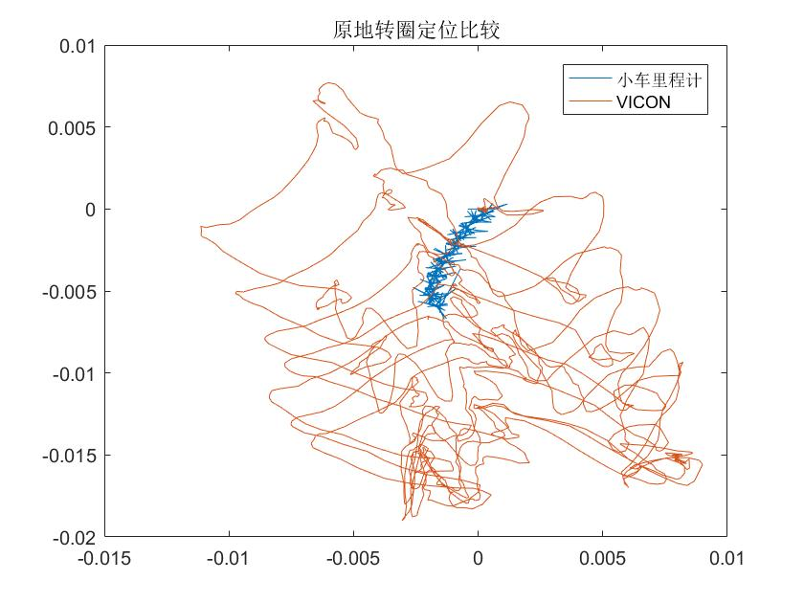
Motion Pattern

Slide 26
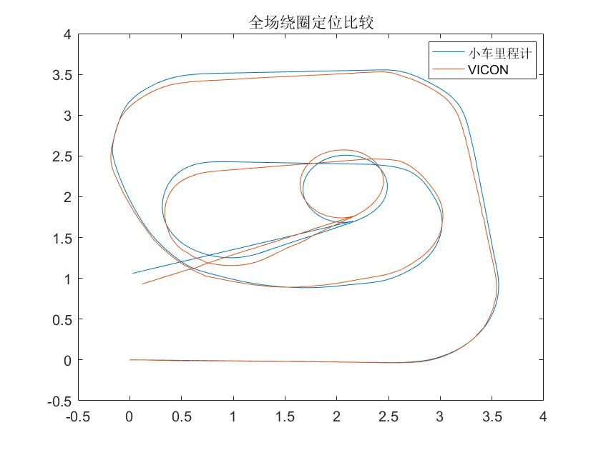
Motion Pattern

Slide 27
Conclusions
To achieve satisfying accuracy:
Avoid high speed;
Avoid backward motion.

Slide 28
Thanks！

